Slide 1
Champions of
Innovation
Presented By:
Dan Holsinger: Genova Diagnostics
Ann Silliman: SCC / RCM

Slide 2
Nursing Home Census

Slide 3
Nursing Home - Required Setup
In order to begin using the Nursing Home Census Module, System Parameters, Clinics and Insurance payors will need to be configured.
  System Parameter: CensusDaysHold
  Clinic Flag: Route Bill to Nursing Home Census
  Insurance Flag: Hold for Nursing Home Census

Slide 4
System Parameter: CensusDaysHold
Parameter Name:
  CensusDaysHold
Parameter Description:
  Determines the number of days to hold a visit from invoicing for Nursing Home Census.
Value:
  Represents the number of days to hold a visit from invoicing. Once the number of days defined in the system parameter has passed, the visit will qualify for invoicing jobs that include visits with expired holds.

Slide 5
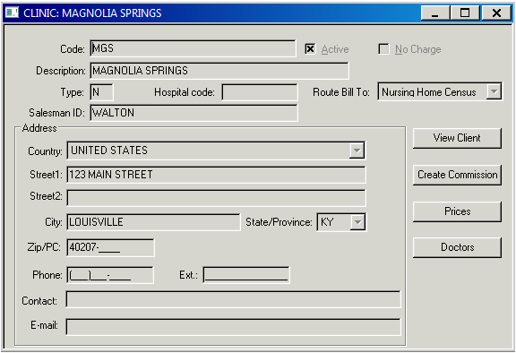
Clinic Setup Flags
In order to qualify for the Nursing Home Census Module, the “Route Bill To” option on the Clinic setup record must be set to “Nursing Home Census”

Slide 6
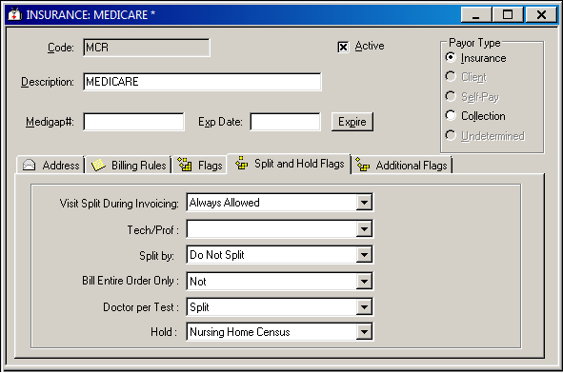
Insurance Payor Setup– Dialog
To complete the qualification requirement for the Nursing Home Census Module, the payor on the visit must have its ‘Hold’ flag set to Nursing Home Census.

Slide 7
Nursing Home
Pulling it all Together

Slide 8
Bill Routing to Nursing Home Census
Visits in SoftA/R are placed on hold for the number of days defined in the system parameter, CensusDaysHold and qualify for the Nursing Home Census Module when the ordering Clinic is set up for Nursing Home routing and:
  The visit does not contain a primary payor
  OR
  The visit primary payor has its ‘Hold’ flag set to Nursing Home Census

Slide 9
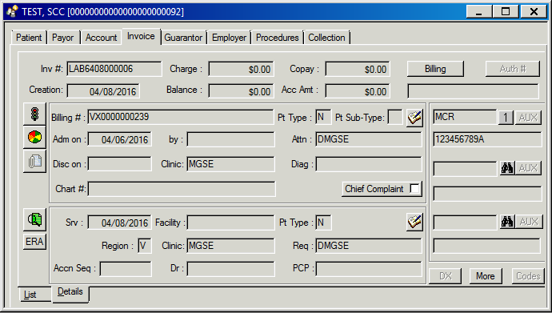
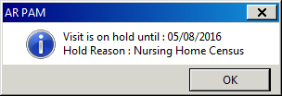
Patient Account Module:
Visit on Hold
When a visit is on hold for Census, the visit status indicator will display a stoplight. When selected, the release date and hold reason are displayed

Slide 10
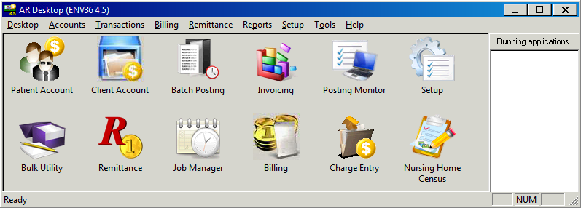


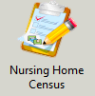
Nursing Home Census Module:
The Nursing Home Census Module is the application in which all visits awaiting census determination reside.

Slide 11
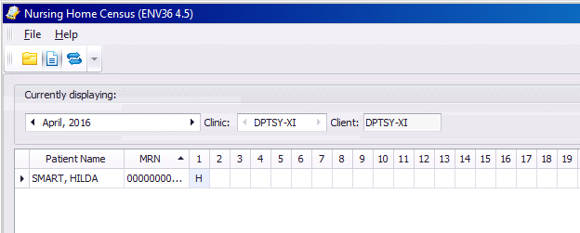
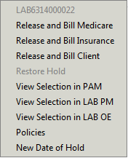
Nursing Home Census Worklist
Once the application is open, the user is presented with a worklist containing all qualified visits from which they can choose the proper assignment.

Slide 12
Payor Determination

Slide 13
System Parameters
From the moment an order enters the SoftA/R system, the following system parameters can help route the invoice to the correct payor:
  Posting Account
  PostingVisitPayor
  InvDefaultPayor

Slide 14
System Parameter: PostingAccount
Parameter Name:
  PostingAccount
Parameter Description:
  Determines the account module (PAM or CAM) in which visits will be placed when the payor on the visit is empty
Possible Values:
  0 - If payor empty, always put order into PAM;
  1 - If payor empty and ward defined as client, put order into client account, otherwise put order into PAM.

Slide 15
System Parameter: PostingVisitPayor
Parameter Name:
  PostingVisitPayor
Parameter Description:
  Determines from where, the visit primary payor is taken
Possible Values:
  0 - Take payor from BINS tag, if it's empty - take from order;
  1 - Take payor from order, if it's empty - take from BINS tag;
  2 - Always take payor from order;
  3 - Always take from BINS tag.

Slide 16
System Parameter: InvDefaultPayor
Parameter Name:
  InvDefaultPayor
Parameter Description:
  Determines to whom empty payor visits are invoiced
Possible Values:
  F - primary payor (Policy tab);
  I - first non-client;
  P - Private;
  E - generate IN81 error

Slide 17
Overcoming Out-Reach Challenges
Payer Redirection Can Help Manage:
  Direct Billing Regulations and Anti Mark-Up Regulations
    NY/NJ/RI Direct Billing Laws
  Pathology/Cytology Billing Limitations by state
  Redirect specific tests TC/PC
  Statutorily Excluded services
    Bill with GY modifier
Clients who always or never want to be billed
  Can be test specific

Slide 18

Payor Redirection
Payor Redirection rules enable an automated change of payor based on any combination of the below criteria available in the grid
Payor Type
System
Patient Type
Clinic/Ward Type
Region
Facility
Test Type (Tech/Prof)
Bill Class
Patient Info

Slide 19
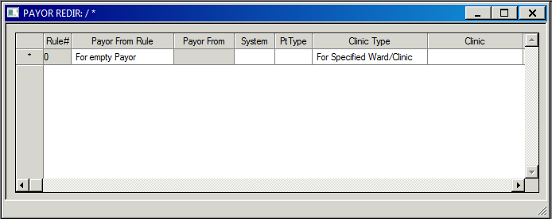
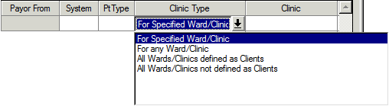
Payor Redirection: Clinic Bill Routing
Three new options were added to the “Clinic Type” condition in the Payor Redirection Setup grid that utilize the “Route Bill To” flag on the Clinic/Ward record
All Wards/Clinics defined as Route Bill to Client Billing
All Wards/Clinics defined as Route Bill to Nursing Home Census
All Wards/Clinics with Route Bill To Not Defined

Slide 20
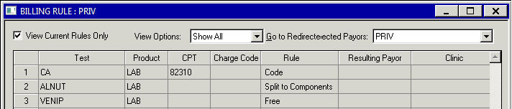
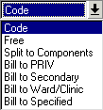
Payor Redirection – Test Level
Commonly used Billing Rules include :
  Code
  Split to Components
  Free
Rules used to redirect the payor at the test level include:
  Bill to Ward/Clinic
  Bill to Specified

Slide 21

Payor Redirection – Test Level
“Bill to Ward/Clinic”
  Allows redirection from the given payor to the Client account linked to the ordering ward/clinic . If the ordering clinic is not linked to a client account, invoicing error IN97 will be claimed.
“Bill to Specified”
  Allows redirection from the given payor to any other specified payor
  Remember
  .... Rules can be defined for specific clinics as well ....

Slide 22
Client Payor Setup:
Back to Basics

Slide 23
Leveraging Opportunities -Special Pricing
Client Special Prices– Price overrides
  Can be uploaded instead of keyed
  Expiration or Evergreen with annual review
Pricing redirection
  Use for multi practice accounts with same pricing
ATB Discounts
  Non discountable flag
  Keeps pricing logical – avoid big adjustments
Can be used together to provide a lot of flexibility in pricing

Slide 24
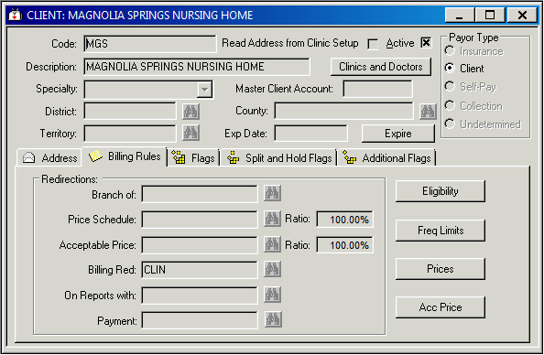
Client Payor Setup Dialog:
Price Redirection
As with Billing Rules, Prices can be redirected to a master fee schedule or other specified payor..
Redirection is defined on the Billing Rules tab in Client setup.

Slide 25

Client Payor Setup Dialog:
Price Ratio
Ratios are used to globally increase or decrease the redirected price for a test.
A ratio of 95% will apply a 5% discount to the redirected price
A ratio of 105% will apply a 5% increase to the redirected price

Slide 26
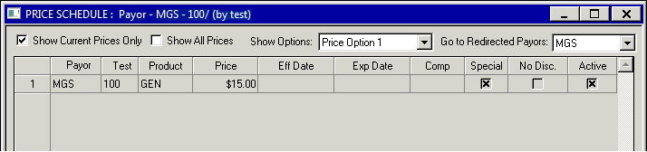
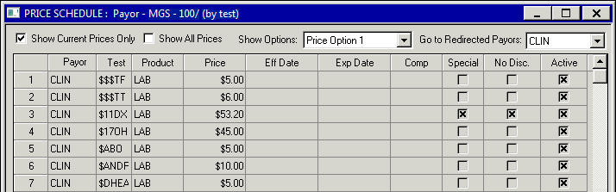


Price Dialog
Redirected Prices with ratio applied can be seen in the price setup grid
Select the redirected payor in the filter
Select “Show Calculated Prices”

Slide 27
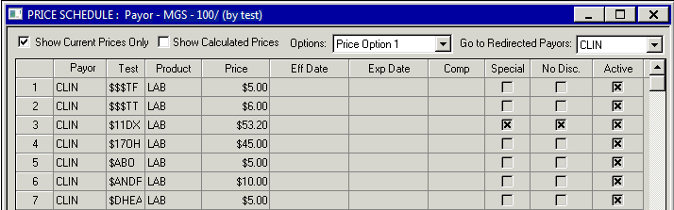
Price Dialog
Tests flagged as “No Disc.” are not subject to the price ratio

Slide 28
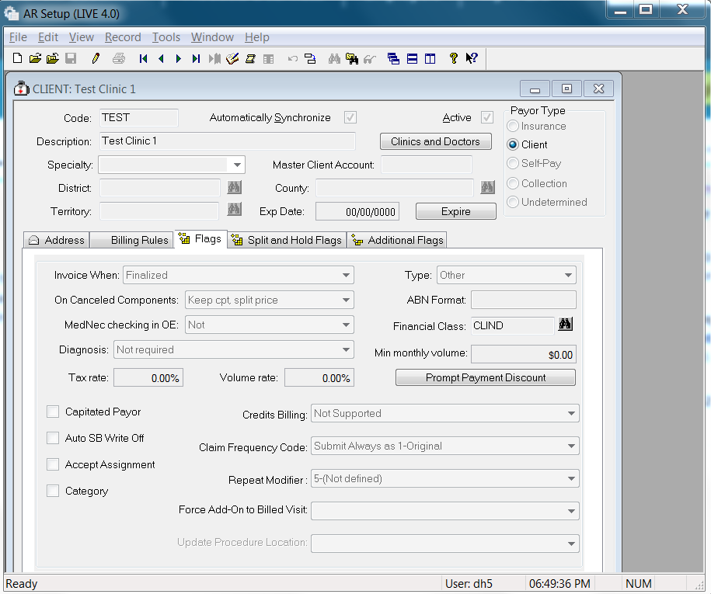
Leveraging Opportunities – Key Flags
Canceled Components
  Keep CPT and Price
  KEEP CPT Split Price

Slide 29
Leveraging Opportunities – Key Flags
Prompt Payment Discount
  Gives client a reason to pay quickly
  Positive collection approach

Slide 30
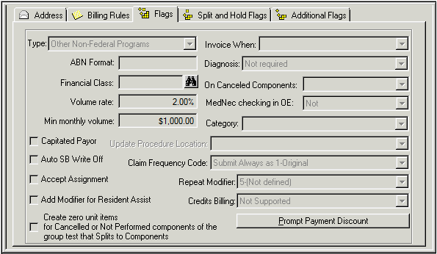

Client Payor Setup Dialog:
Prompt Payment Discount
Prompt Payment discounts are added as payments are applied to a client statement period within the specified terms.
To define a Prompt Payment Discount, select the Flags tab, choose Prompt Payment Discount and enter the desired information.

Slide 31
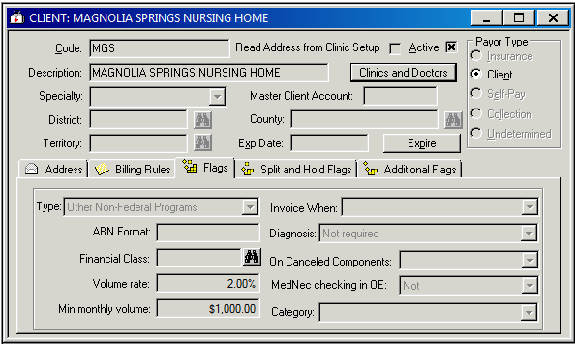
Client Payor Setup Dialog:
Volume Discounts
Volume based discounts are calculated during the Month Close process for client accounts.
To add a volume rate and monthly minimum, select the ‘Flags’ tab in Client setup and enter the desired information.

Slide 32
Client Account Module
(CAM)

Slide 33
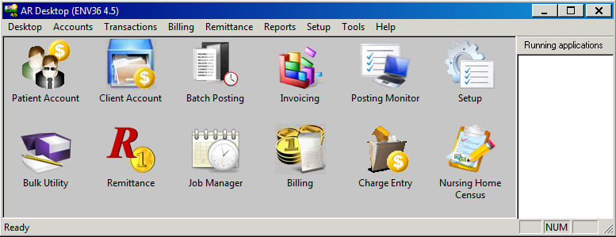


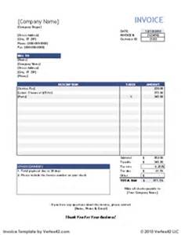
CAM
The Client Account Module (CAM) is the SoftA/R application from which direct client billed activity originates.

Slide 34
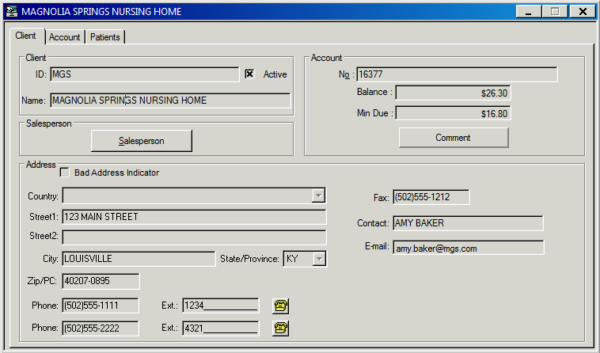
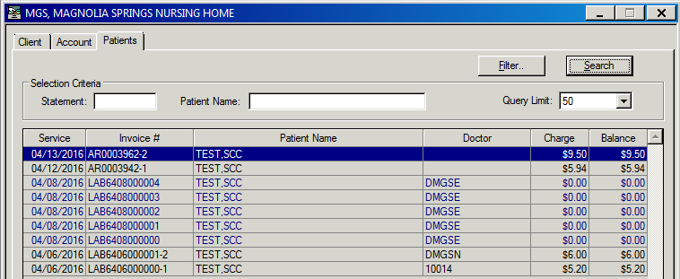
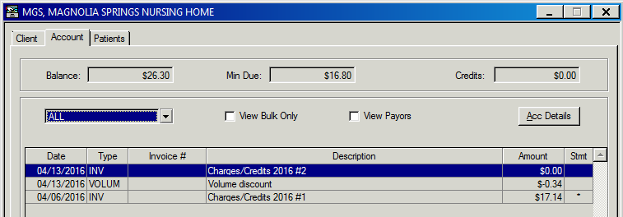
CAM – Overview
The “Client” tab provides demographic, contact and account information
The “Account” tab provides an overview of the account including balance, minimum due, credits and a comprehensive transaction listing.
The “Patients” tab displays outstanding patient invoices owed by the client and visits not yet invoiced.

Slide 35
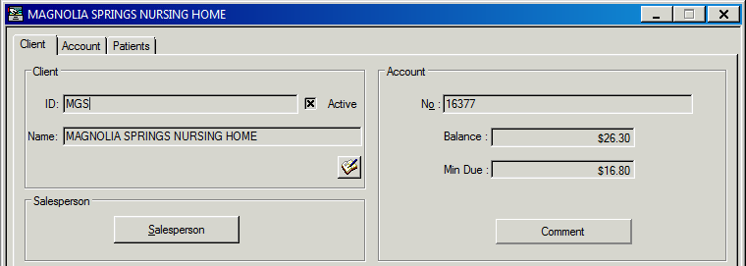
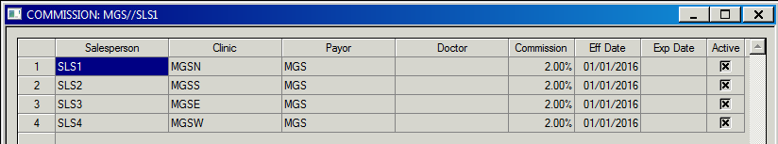
CAM - Salesperson
If there is a Salesperson linked to the Client payor, the sales and commission data is accessible through the “Salesperson” button on the ‘Client’ tab.
The button provides access to the data from setup which includes Salesperson code, linked clinic, payor, doctor, commission rate and effective/expiration dates.

Slide 36
Leveraging Opportunities –Non-testing Revenue
“MIS” Codes
  Can use units and set price at $.01, $1to manage variable costs
Billing for Cal-Pro and P/E Kits
Billing for Expedited Shipping Charges
Billing for Tubes/supplies to international customers
A/R transfer for Billing Consolidation
Billing for seminars and books

Slide 37
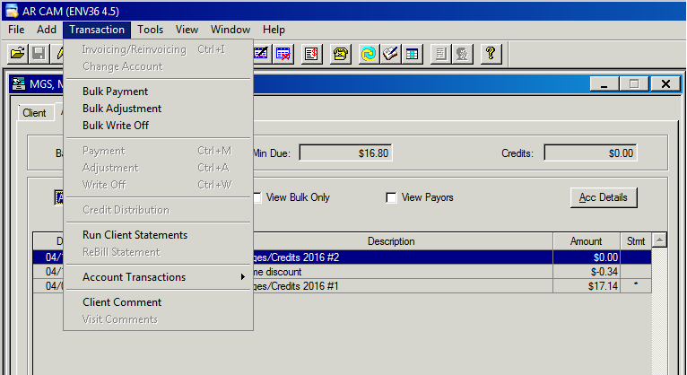
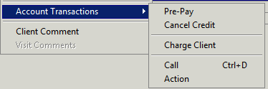
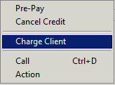
CAM – Non Testing Revenue
Non Testing Revenue can be added to the client account through the Transaction Menu in CAM.

Slide 38
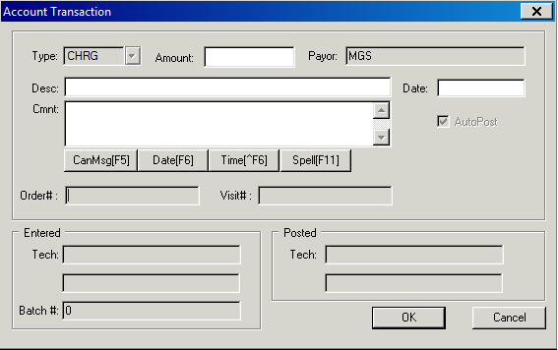
CAM – Non Testing Revenue
The account transaction dialog provides the ability to add the amount, description, date and comment to further describe the charge.
Additional information about the charge

Slide 39
Statements and Reports

Slide 40
Leveraging Opportunities – Client Statements
Consolidated Billing for large practices
  Assigning multiple Doctors to a single ward
  Single bill – custom sort
Multiple Statement formats
  Different types for different clients
  US Vs UK Customers
  CPT Codes Y/N?
  PDF/Excel output
Nursing Home Part A and Part B
  Mid month and special billing cycles
  Timely and accurate cost report crucial to NH cash flow- and yours!

Slide 41
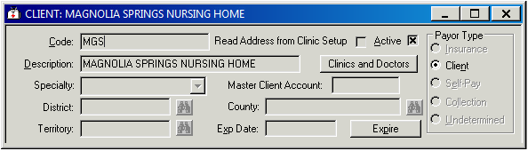
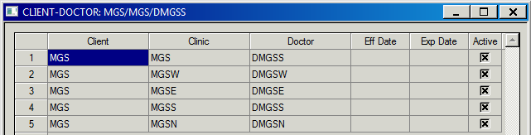
Client Payor Setup Dialog:
Clinics and Doctors
The Clinics and Doctors button, available in Client setup, provides the ability to link doctor and clinic records to a billable client account.

Slide 42
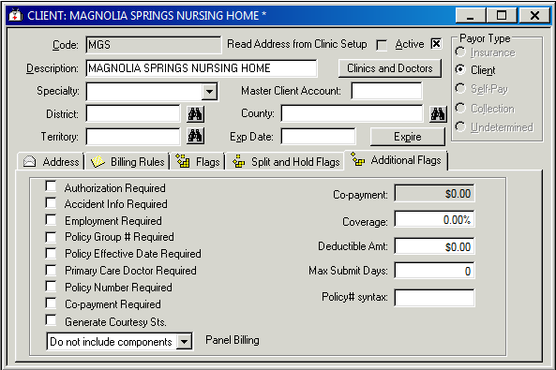
Client Payor Setup – Billing Flags
Panel Billing
The Panel Billing option provides the ability to display components of a group test that is billed at the panel level.
When “Do not include components” is selected, Group Tests (billed at code) will appear on the client statement without their components.
When “Include components” is selected, Group Tests (billed at code) will appear on the client statement along with their components.
In order to utilize this feature, the value of the system parameter, InvPanelBillingCode, must be used as the CPT code in the billing rule for the Group Test.

Slide 43
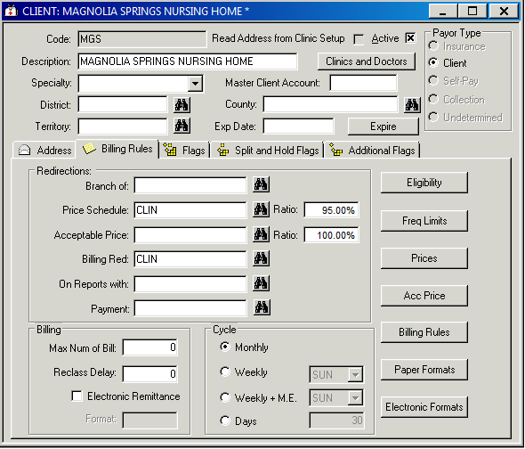
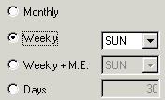
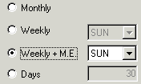
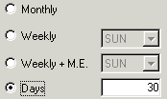
Client Payor Setup –
Billing Flags
Billing Cycle
Billing Cycle
  Monthly
  Weekly
  Weekly + M.E.
  Days

Slide 44
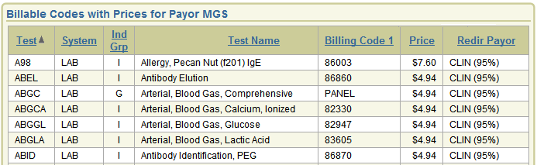
APEX Reports
Current Prices Report
  Provides the price schedule and billable codes for the requested payor, utilizing price redirections and ratio, where defined.
Notes:
Add descriptions from APEX Training Manual

Slide 45
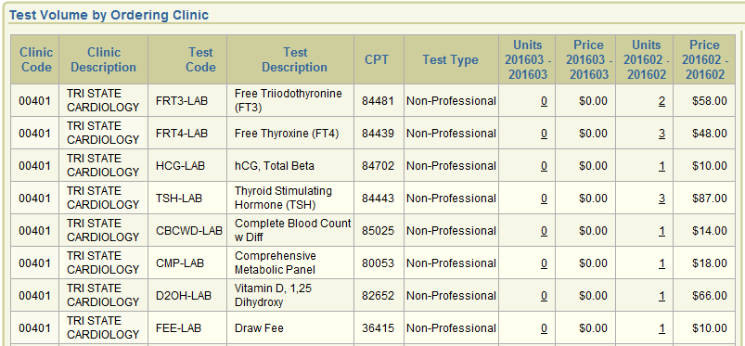
APEX Reports
Test Volume by Clinic
  Provides invoiced test counts by Ordering Clinic for a user defined set of criteria.

Slide 46
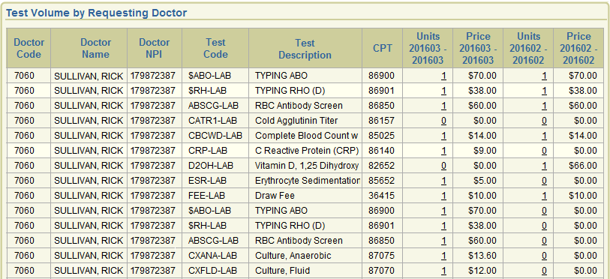
APEX Reports
Test Volume by Dr
  Provides invoiced test counts by Requesting or Performing Doctor for a user defined set of criteria.

Slide 47
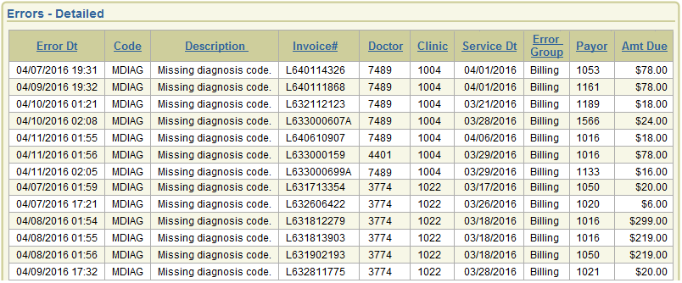
APEX Reports
Error Report
  The APEX Errors Report qualifies the same errors that are available from the Job Manager Error Logs in a comprehensive, easy to view format that is exportable to excel.
  The output contains both requesting doctor and ordering clinic to assist in the follow up for missing information required for billing.

